Slide 2
Conceptual design

Slide 3
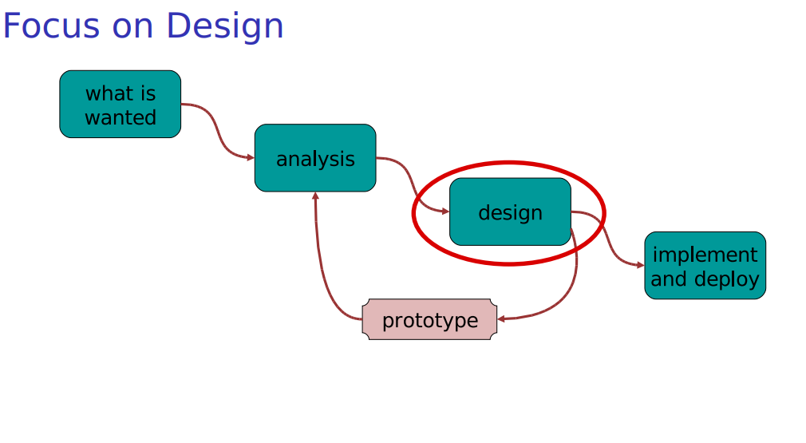
How do we actually do the design?
Temptation: start sketching windows, menus and buttons.
But we can do better by starting from thinking about the user experience we want to provide.

Slide 4
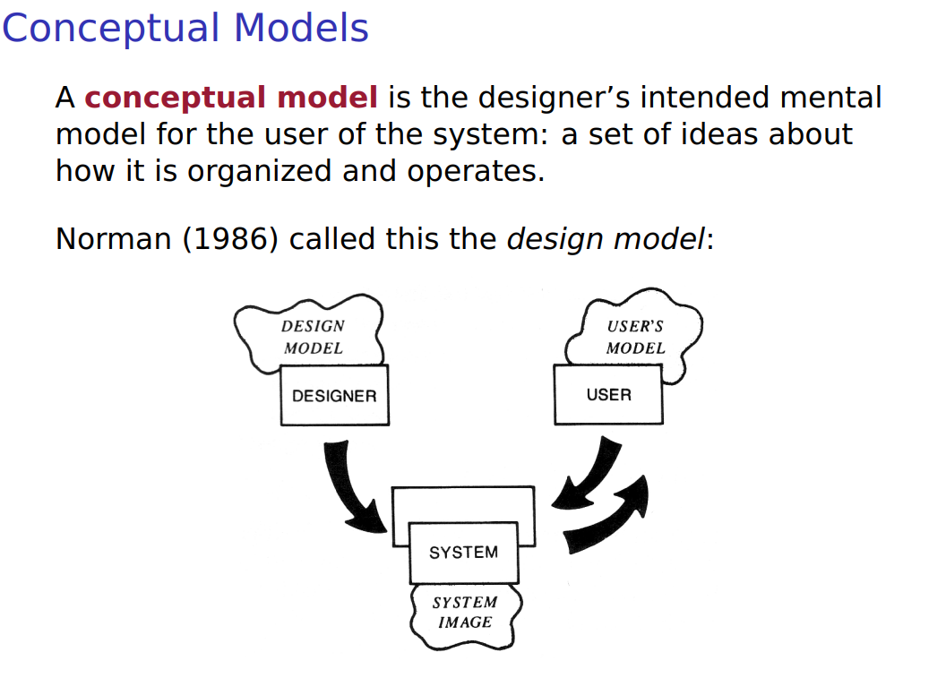

Slide 5
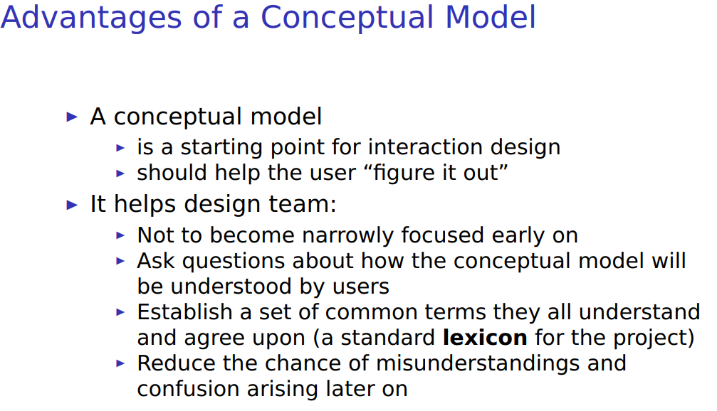

Slide 6
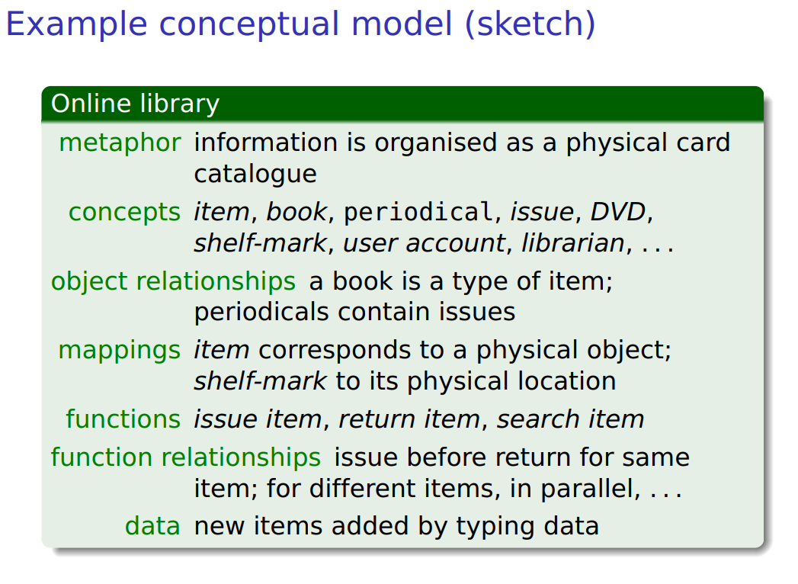

Slide 7
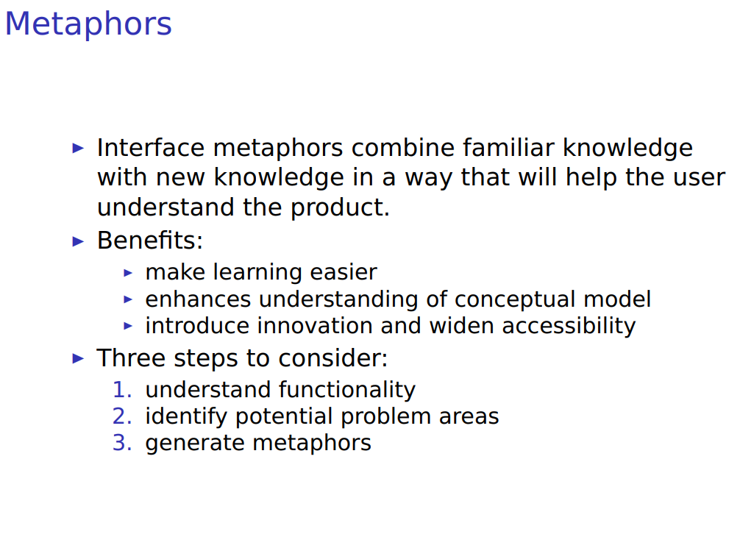

Slide 8
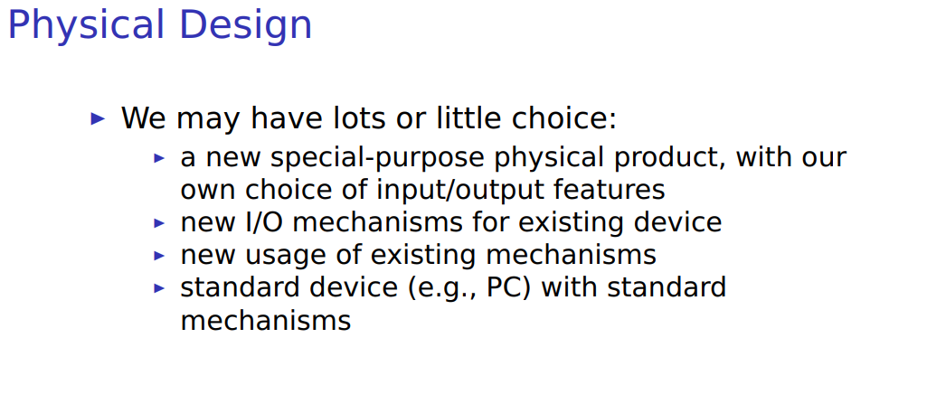

Slide 9
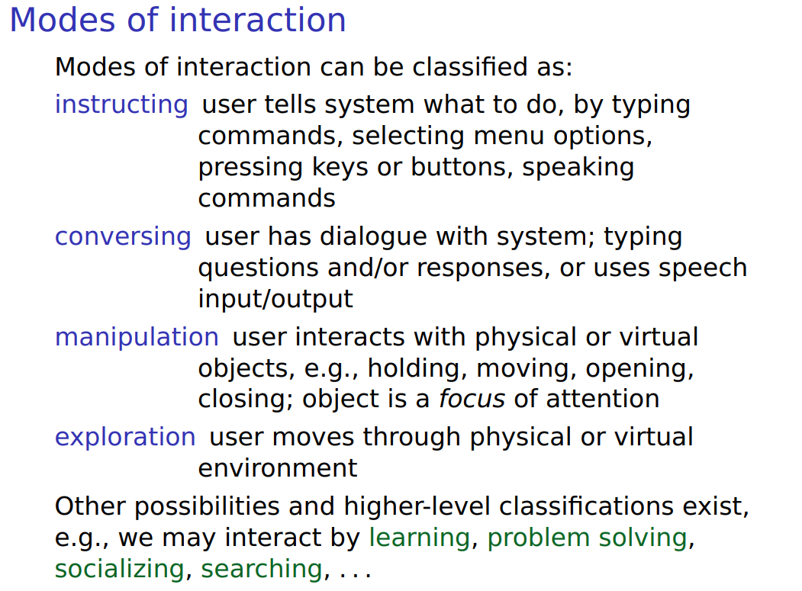

Slide 10
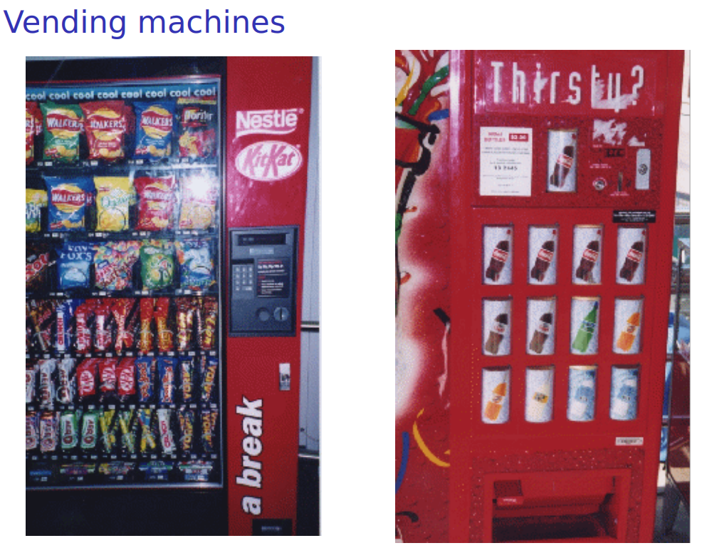
Notes:
instructing

Slide 11
